Slide 1
BAND-GUARD
~ A safeguard for women!

Slide 2
PROJECT TITLE : BAND-GUARD
A Safeguard for Women
STUDENT NAME : 1. Mythili R
2. Mathiyazhagi B
3. Abarna M
4. Medasani Likhitha
5. Bandaru Krishna Keerthana
STAFF NAME : Dr.G. Nalinipriya, M.E.,Ph.D.,
Professor.

Slide 3
AGENDA
01
07
HARDWARE REQUIREMENTS
02
08
SYSTEM ARCHITECTURE
03
09
PROJECT MODULES
04
10
PROPOSED SYSTEM
OUTCOMES
05
11
CONCLUSION
06
12
REFERENCES
ABSTRACT
LITERATURE SURVEY
EXISITING SYSTEM
HARDWARE REQUIREMENTS
SOFTWARE REQUIREMENTS

Slide 4
ABSTRACT
In the modern era, technology is growing faster every day. But on the other side, women and girl children are feeling insecure while going out due to the increase of crimes against them in all aspects. To resolve this problem , we have come out with a smart device BAND-GUARD - HAIRBAND, which is built with GPS tracking system with SOS Panic Button. If a women or girl children feels that she is in trouble or insecure, she can press the SOS button in GPS which we have fixed in the hairband (band-guard device), because hairband is a thing that girl children and women use daily. By clicking the panic button, this device sends their location to their family, friends or nearby police station with an alert message that she is in trouble.

Slide 5
LITERATURE SURVEY
Sutar Meghaet al [1] The Sutar Megha et al [1] The Sexual Harassment of Women at Workplace (Prevention, Prohibition and Redressal) Act,2013.
Anup CJetal [2] The amount of violence against women has increased by many folds due to the greater exposure of women in every field of life.
Shreyaasha chaudauryet al [3] Safety of Women in India has become a major issue in India now.
Snehal Lokesh et al [4] , Violence against women and girls does not discriminate by race, religion, culture, class or country.
Swati Sharma et al [5] , Safety for women become a matter of concern with the violence against the women will increases, in this system the GPS tracking and messaging system plays an important role.

Slide 6
LITERATURE SURVEY
Junaid Mohammed et al [6] this paper is built on the android app based on their mobile application for the health monitoring.
The paper [7] proposes an application called women empowerment. This
application can be installed in the smart phones.
The paper [8] focuses on a security system that is designed merely to serve the
purpose of providing security to women so that they never feel helpless.
The paper [9] proposes a concept of portable equipment which can be carried by the women which consists of a GPS, GSM model, LCD display and a physical button.
The paper [10] conducts a survey of 10 papers which are on women safety and security.

Slide 7
EXISTING SYSTEM
In November 2012, The WHO Department of Reproductive Health and Research formed a group of specialists to examine well-being segment-based research to react to savagery against women . Earlier this system developed an app which required Smartphone. From the research paper by Ashwini.P. This device had a great use for women safety too.She developed a one-touch alarm based device including an emergency call for helping which did not require a Smartphone. Likewise Smart device,Voice app,SHE,AESHS,VithU app,Smart Belt. But these smart GPS tracking devices are not so effective.

Slide 8
PROPOSED SYSTEM
SECURE
ACCESSIBLE
FAST AND RELIABLE
TO ENSURE WOMEN AND GIRL CHILDREN SECURITY AND SAFETY
TO PROVIDE EASY ACCESS FOR WOMEN AND GIRL CHILDREN ANYTIME AND ANYWHERE
TO ALLOW THE USER TO TRACK THE LOCATION EASILY AND TO GET ALERT MESSAGE OR NOTIFICATION ANY TIME ANYWHERE

Slide 9
PROPOSED SYSTEM
For the purpose of giving instant safety especially women, safety devices are introduced. Our ultimate goal is to bring safety through our device which has GSM; GPS to track location with state-of- the-art technology refers to the top stage of development.When this system is started GPS and GSM module will be initialized. Once GPS and GSM module are initially ready, it will be able to receive data. After pressing the push button, firstly buzzer will be buzzed continuously for 3 seconds, then the shock generator will be activated for 10 seconds. And alert message will be sent to the user from victim,The main purpose of this device BAND_GUARD is to intimate the parents or friends or guardian about the current location of the women or girl children. An inbuilt GPS system is used to trace the current position of the victim and the message or notifications will be sent to the pre-defined numbers.

Slide 10
DOMAIN INTRODUCTION
NETWORKING
MOBILE COMMUNICATION
GPS TRACKING SYSTEM

Slide 11


NETWORKING
A network is a collection of computers,servers, mainframes, network devices, peripherals, or other devices connected to one another to allow the sharing of data.
An of a network is the Internet, which connects millions of people all over the world.
To the right is an example image of a home network with multiple computers and other network devices all connected.

Slide 12
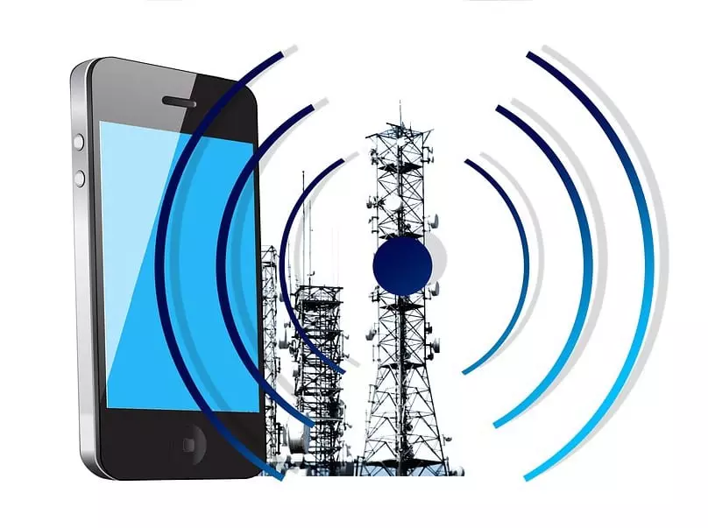
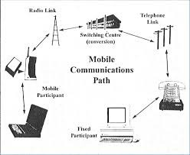
MOBILE COMMUNICATION
Mobile Communication is the use of technology that allows us to communicate with others in different locations without the use of any physical connection (wires or cables).
Mobile communication makes our life easier, and it saves time and effort.

Slide 13
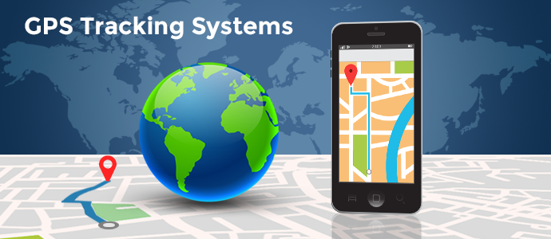
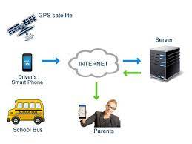
GPS TRACKING SYSTEM
Global Positioning System tracking is a method which works by providing information on exact location. It can also track the movement of a vehicle or person.
So, for example, a GPS tracking system can be used by a company to monitor the route and progress of a delivery truck, and by parents to check on the location of their child, or even to monitor high-valued assets in transit.

Slide 14

HARDWARE AND SOFTWARE REQUIREMENTS
HARDWARE COMPONENTS OR DEVICES:
GPS MODULE
SOS PANIC BUTTON
GSM MODULE
HAIRBAND
WATERPROOF MATERIAL
SOFTWARE COMPONENTS OR DEVICES:
GOOGLE MAPS
ANDROID IDE

Slide 15
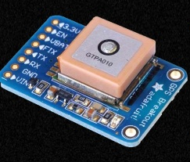
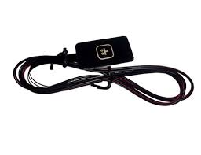
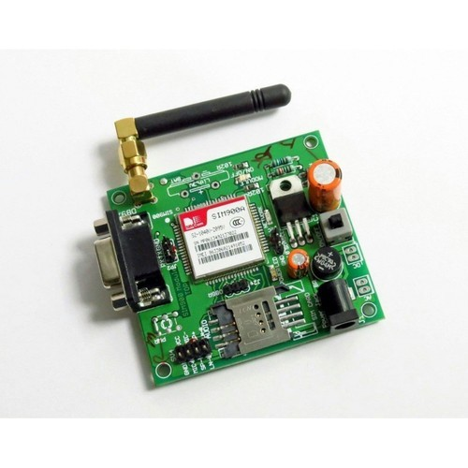
HARDWARE REQUIREMENTS
GPS MODULE
SOS PANIC BUTTON
GSM MODULE
Location — Determining a position.
Navigation — Getting from one location to another.
Tracking — Monitoring object or personal movement.
Mapping — Creating maps of the world.
Timing — Making it possible to take precise time measurements.
A GSM modem or GSM module is a hardware device that uses GSM mobile telephone technology to provide a data link to a remote network. From the view of the mobile phone network, they are essentially identical to an ordinary mobile phone, including the need for a SIM to identify themselves to the network.
The SOS buttons are discreet devices that give the user the ability to send an SOS alert to quickly communicate with help or a trusted person by using GSM/GPS/GPRS technologies.

Slide 16
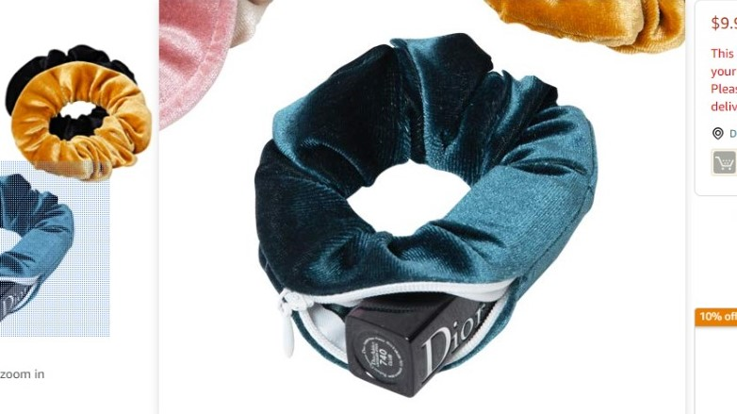
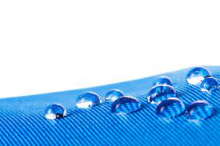
HARDWARE REQUIREMENTS
WATERPROOF MATERIAL
HAIRBAND
This Hairband has an zipper so it is very spacious and we can keep many things in it.
Water-resistant: able to resist the penetration of water to some degree but not entirely. Water-repellent: not easily penetrated by water, especially as a result of being treated for such a purpose with a surface coating.

Slide 17

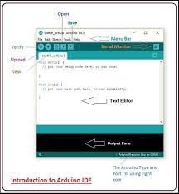
SOFTWARE COMPONENTS
ARDUINO IDE
Arduino Integrated Development Environment
The Arduino Integrated Development Environment - or Arduino Software (IDE) - contains a text editor for writing code, a message area, a text console, a toolbar with buttons for common functions and a series of menus. It connects to the Arduino and Genuino hardware to upload programs and communicate with them.

Slide 18
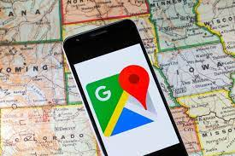
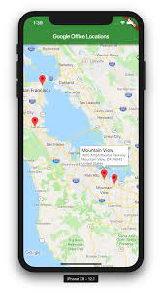

SOFTWARE COMPONENTS
GOOGLE MAPS
Google Maps API is a web mapping service developed by Google.
It offers satellite imagery, aerial photography, street maps, 360° interactive panoramic views of streets (Street View), real-time traffic conditions, and route planning for traveling by foot, car, bicycle, air (in beta) and public transportation.

Slide 19
SYSTEM ARCHITECTURE
ALGORITHM:
STEP 1: Start.
STEP 2: Activate GPS Tracker by pressing ON/OFF Button.
STEP 3: Press SOS Panic Button.
STEP 4: Buzzer gets activated and it gives alert to GPS to read data.
STEP 5: GPS Tracker reads data.
STEP 6: GPS activates GSM SIM module to send SMS i.e alert message from victim to the user as “ HELP ME!! + (Geolocation of Victim)”.
STEP 7: User tracks the Victim’s Location.
STEP 8: Stop.

Slide 20
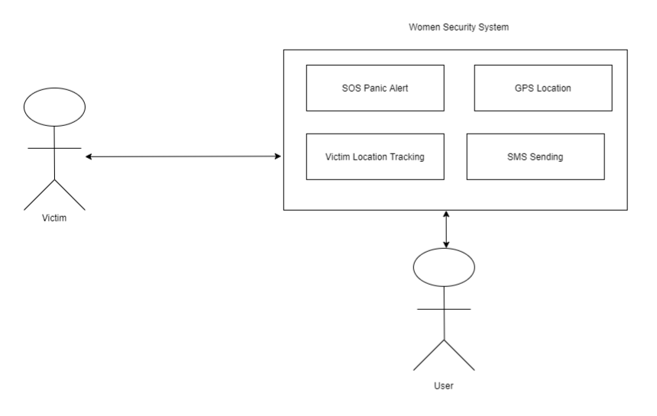
SYSTEM ARCHITECTURE

Slide 21
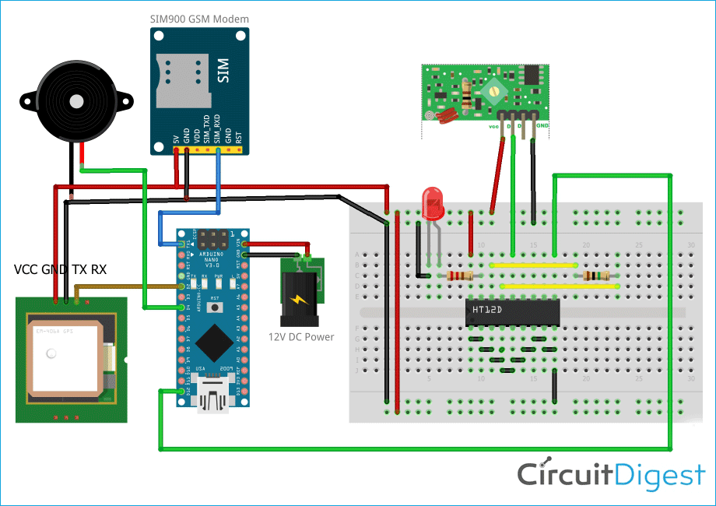
CIRCUIT ANALYSIS
Circuit connection of Band-Guard

Slide 22
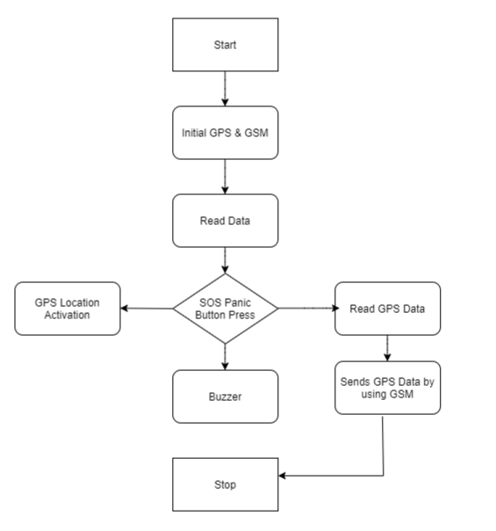
FLOWCHART

Slide 23
BLOCK DIAGRAM
SOS PANIC BUTTON STIMULATES GPS TO WORK
PRESS SOS PANIC BUTTON
GPS SENDS ALERT SIGNAL WHEN SOS BUTTON IS PRESSED
GPS SENDS ALERT SIGNAL
GSM SENDS ALERT NOTIFICATION
VICTIM LOCATION IS TRACKED LIVELY USING GOOGLE MAP.
GOOGLE MAP TRACKS LIVE LOCATION
GSM MODULE WHICH IS INBUILT IN THE GPS TRACKER SENDS ALERT MESSAGE AND THE LIVE LOCATION OF VICTIM.

Slide 24
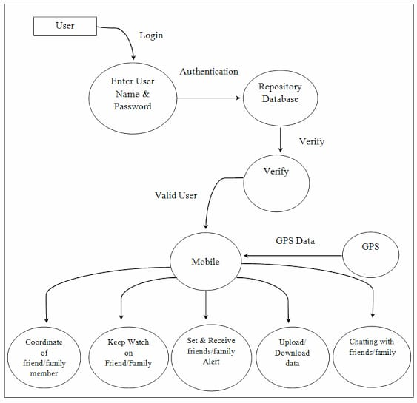
PROJECT MODULES
DATA FLOW DIAGRAM

Slide 25
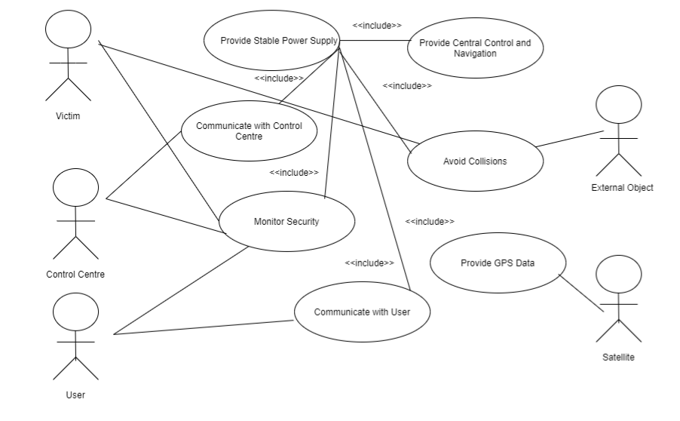
UML DIAGRAMS
USE CASE DIAGRAM

Slide 26
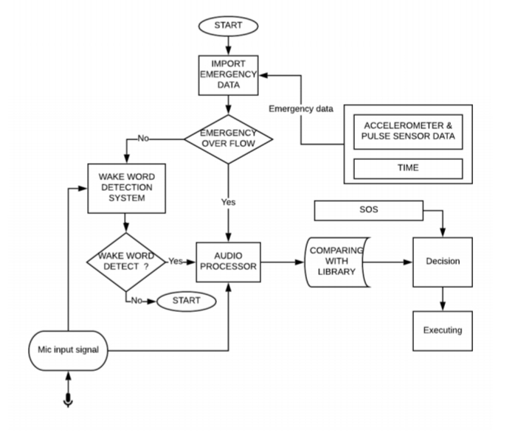
ACTIVITY DIAGRAM

Slide 27
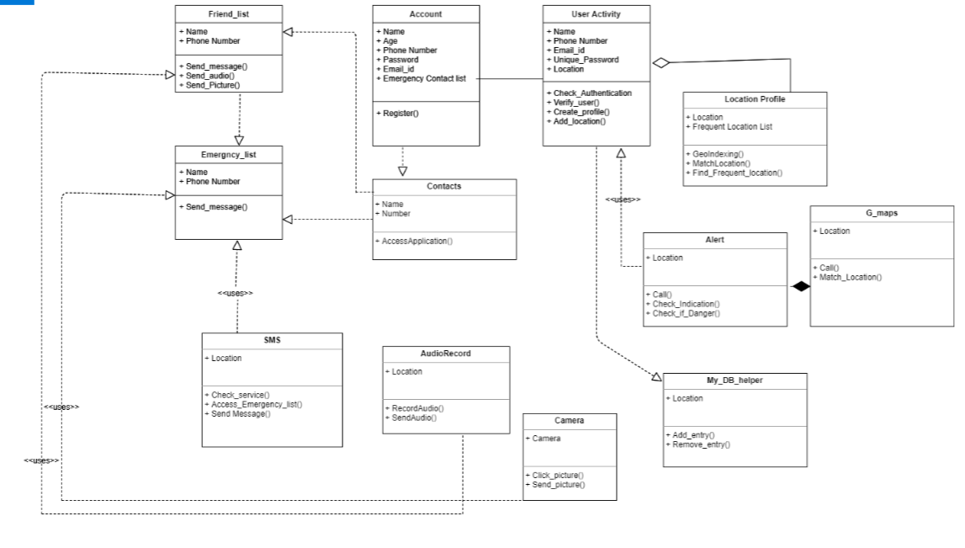
CLASS DIAGRAM

Slide 28
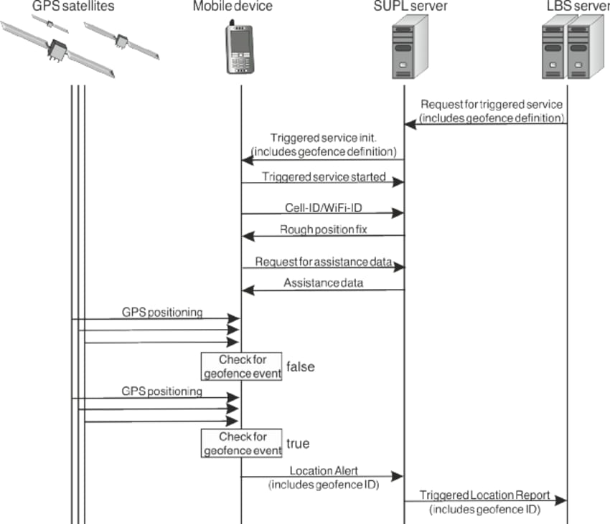
SEQUENCE DIAGRAM

Slide 29
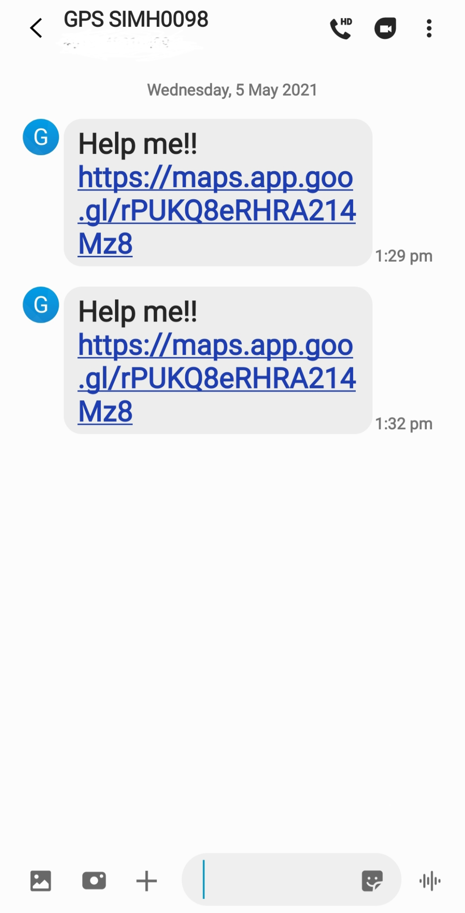
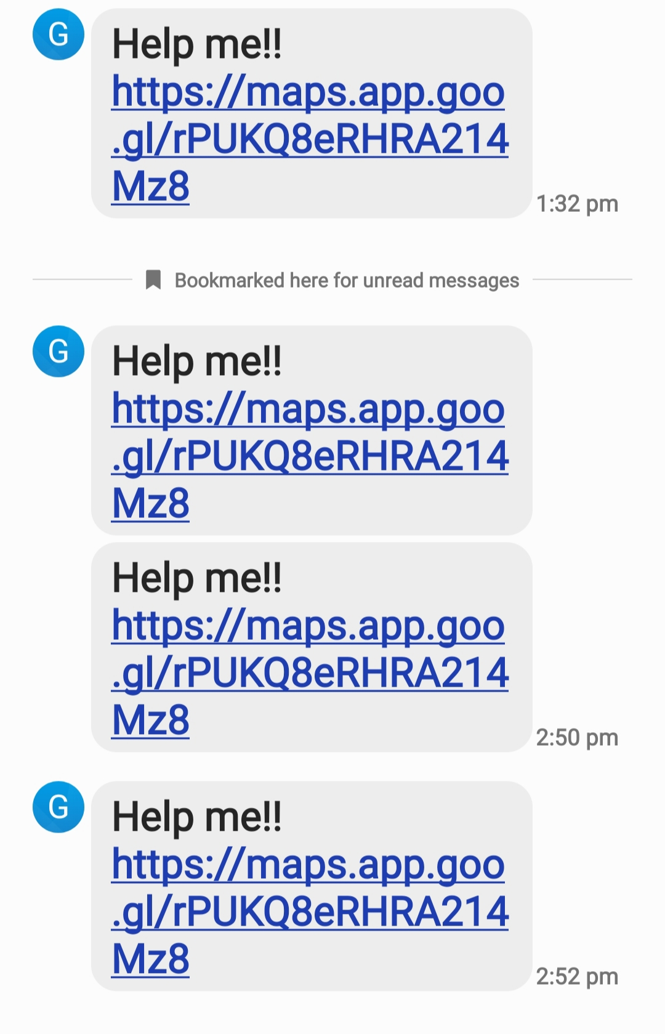
OUTCOMES

Slide 30
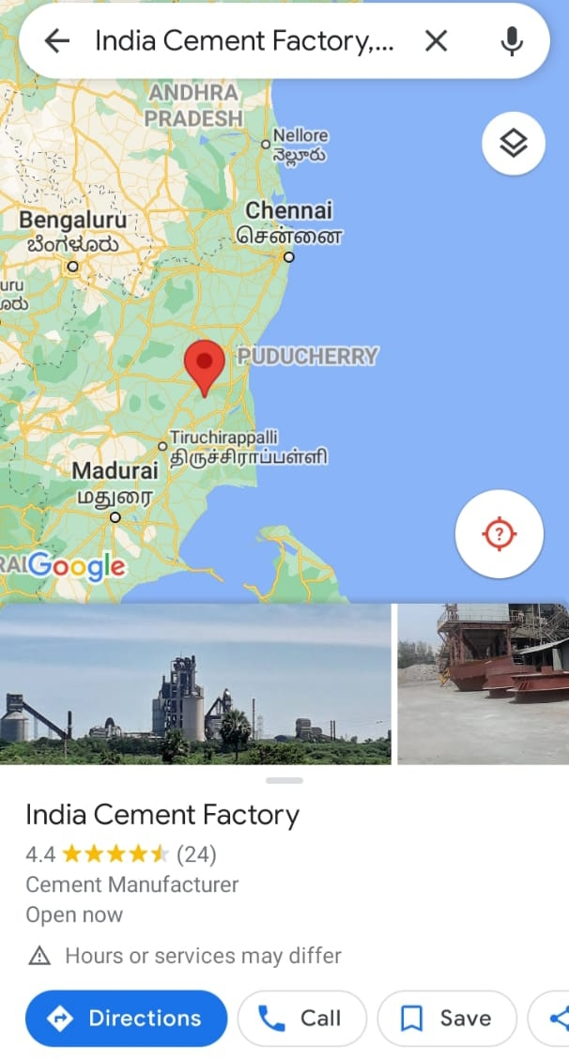

OUTCOMES

Slide 31
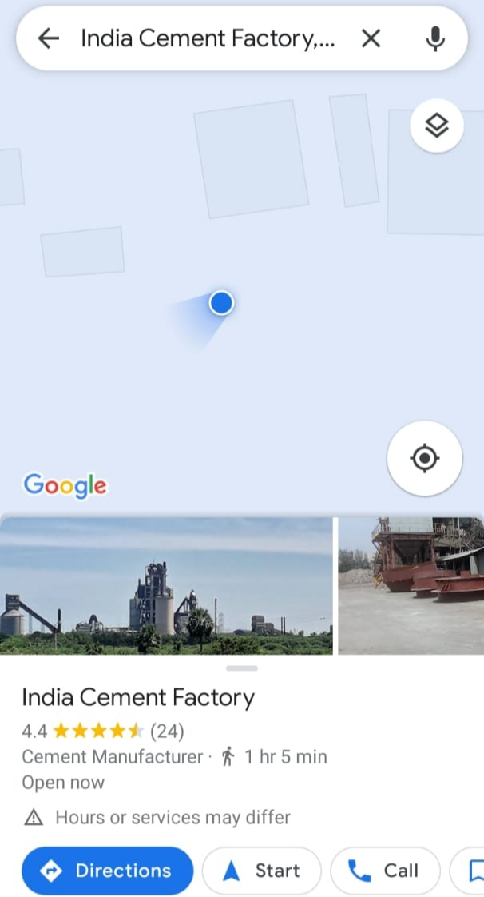
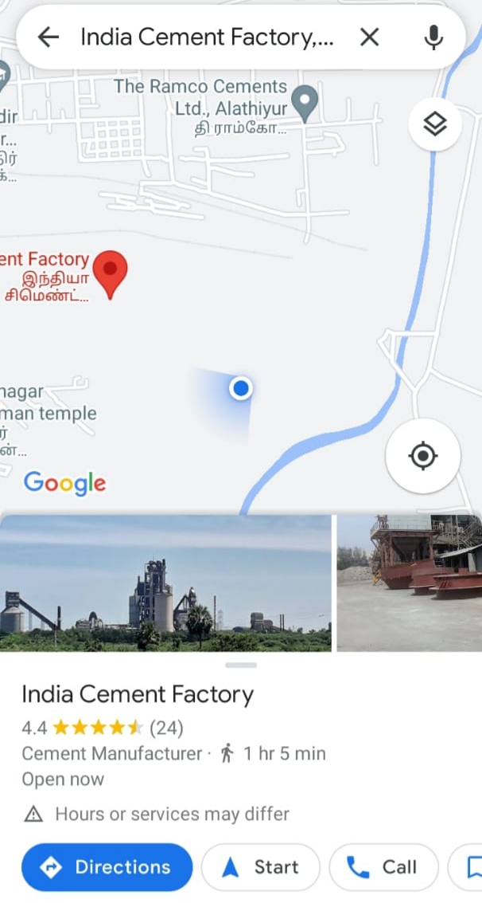
OUTCOMES

Slide 32
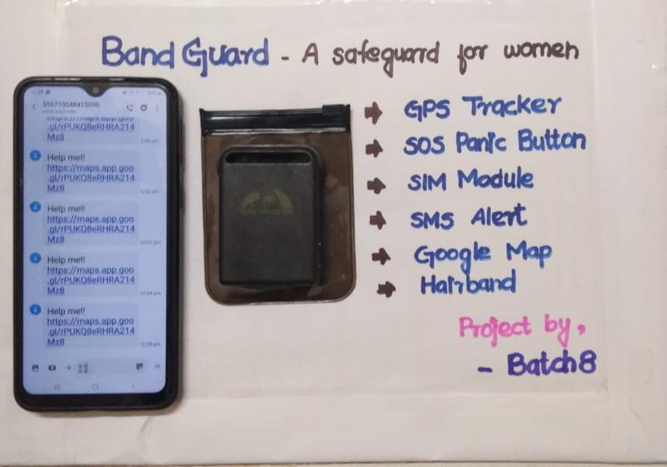
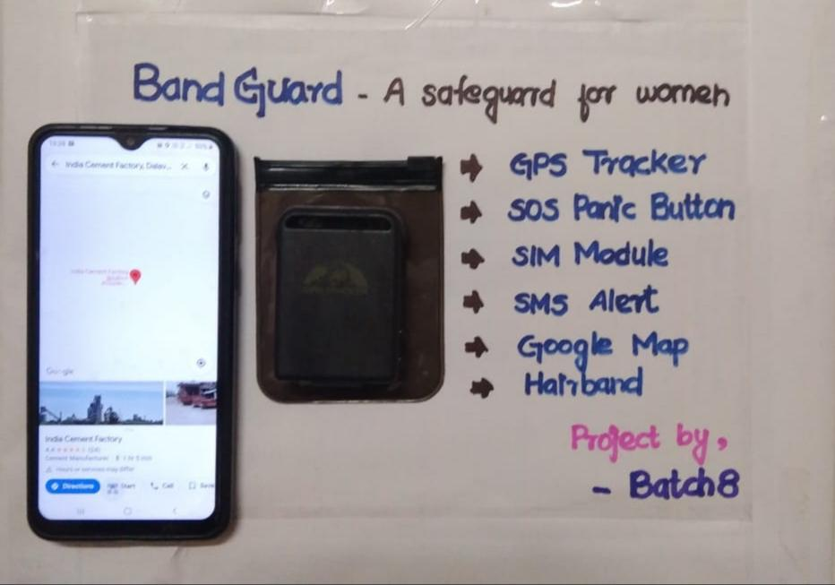
OUTCOMES

Slide 33
REFERENCES
1. Md. Mohsin Sarker Raihan; M. Raihan; Laboni Akter, "A Comparative Study to Predict the Diabetes Risk Using Different Kernels of Support Vector Machine", IEEE International Conference on Robotics, Electrical and Signal Processing Techniques,2021. https://ieeexplore.ieee.org/document/9331206
2.Farrukh Aslam Khan; Khan Zeb; Mabrook Alrakhami; Abdelouahid Derhab, "Detection and Prediction of Diabetes using Data Mining: A Comprehensive Review", IEEE Access, 2021. https://ieeexplore.ieee.org/document/9354154

Slide 34
REFERENCES
3. Amani Yahyaoui; Akhtar Jamil, "A Decision Support System for Diabetes Prediction Using Machine Learning and Deep Learning Techniques,"1st International Informatics and Software Engineering Conference, 2019. https://ieeexplore.ieee.org/document/8965556
4. Zhiyuan Fan; Xuan He; Luyang Wang; Jing Lv, "Research on entity relationship extraction for diabetes medical literature", IEEE 9th Joint International Information Technology and Artificial Intelligence Conference , 2020. https://ieeexplore.ieee.org/document/9338931

Slide 35
REFERENCES
5.Anu Sharma, "Performance Comparison of Classification Models for Diabetes Prediction“, Informatics in Medicine Unlocked, vol. 10, pp.100-107, 2018. https://ieeexplore.ieee.org/document/9337123
6. R. Ziegler et al., "A Risk Prediction Model for Type 2 Diabetes Based on Weighted Feature Selection of Random Forest and XGBoost Ensemble Classifier", IEEE International Conference on Advanced Computational Intelligence,2019. https://ieeexplore.ieee.org/document/8778622
7. S. Mohan, C. Thirumalai and G. Srivastava, "Effective Heart Disease Prediction Using Hybrid Machine Learning Techniques", IEEE Access, vol. 7, pp. 81542-81554, 2019. https://ieeexplore.ieee.org/document/8740989

Slide 36
REFERENCES
8. S. M. Mahedy Hasan; Md. Fazle Rabbi, "An Effective Diabetes Prediction System Using Machine Learning Techniques", IEEE International Conference on Advanced Information and Communication Technology (ICAICT), 2020. https://ieeexplore.ieee.org/document/9333497
9. Md. Shafiqul Islam, Marwa K. Qaraqe "Advanced Techniques for Predicting the Future Progression of Type 2 Diabetes,“, IEEE Access, Vol 8, 2020 https://ieeexplore.ieee.org/abstract/document/9127427
10. Amit M. Joshi; Urvashi P. Shukla, "Smart Healthcare for Diabetes During COVID-19", IEEE Consume Electronics Magazine, Volume: 10, Issue: 1, 2021. https://ieeexplore.ieee.org/document/9174644

Slide 37
CONCLUSION
Thus the women safety system-BANDGUARD is assured and it is all the way set to use by tracking the user whenever they are in danger. The accurate location is shared and thus it helps in all aspects of safety for women. Keep wearing and carry these GPS bands for safety. The zipper rubber band is portable and replaceable so that you can carry yours and change any color of your choice whenever needed. It is also waterproof material and it is specially designed for women.

Slide 38
THANK YOU!

